Slide 1

Project Title - Seasonal Agriculture Performance Analysis
[ Student Name – AMAN PATEL ]
[ College Name – Kanpur Institute of Technology , Kanpur ]
AICTE STU ID : ( STU6918a2f426c2e1763222260 )

Slide 2

PROBLEM STATEMENT
Core Challenge: Agricultural productivity and economic returns fluctuate heavily across seasons due to unpredictable weather patterns, variable resource availability, and uneven farming practices.
Data Gap: Raw agricultural logs contain disparate environmental, soil, and yield figures that do not intuitively explain performance gaps or inefficiencies between cropping seasons.
Objective: Perform exploratory data analysis and statistical validation on multi-season farm data to uncover key seasonal trends, input efficiencies, and operational bottlenecks to enable data-driven agricultural planning.

Slide 3
Project Description :- [ Dataset Scope: Evaluates 4,000 farm profiles across Kharif, Rabi, and Zaid seasons, capturing 28 distinct attributes including weather variables, soil chemistry, irrigation types, and financial metrics. End-to-End Pipeline: Data Wrangling: Imputed missing values across rainfall, soil moisture, and crop yield using seasonal and crop-wise median imputations. Feature Engineering: Derived operational metrics including Profit per Hectare, Cost per Hectare, Revenue per Hectare, and Total NPK usage. Statistical & Visual Analysis: Executed One-Way ANOVA tests alongside 10 visual models to benchmark seasonal variations in yield, irrigation efficiency, and profit margins . ]

Slide 4

WHO ARE THE END USERS?
Farmers & Producer Organizations (FPOs): Guides optimal seasonal crop selection, reduces input waste, and highlights cost-effective irrigation methods.
Agricultural Policy Makers & Extension Officers: Informs targeted subsidy distribution, water conservation planning, and regional yield forecasting.
Agri-Fintech & Insurance Providers: Supplies risk-profiling benchmarks based on seasonal disease risk and climate variability to design fair credit and crop insurance policies.

Slide 5

Technology Used
Programming & Environment: Python 3, Google Colab, Google Drive
Data Manipulation: Pandas, NumPy
Statistical Modeling: SciPy (scipy.stats for One-Way ANOVA and hypothesis validation)
Data Visualization: Matplotlib, Seaborn

Slide 6
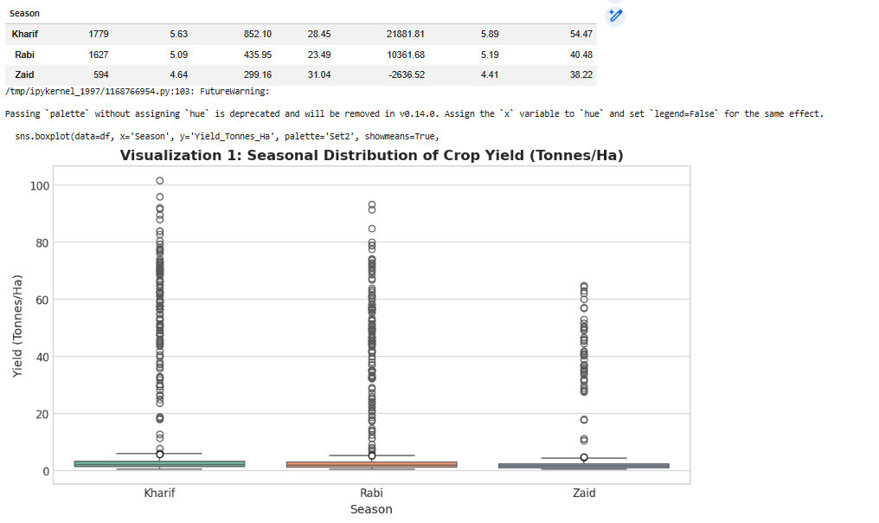
RESULTS

Slide 7
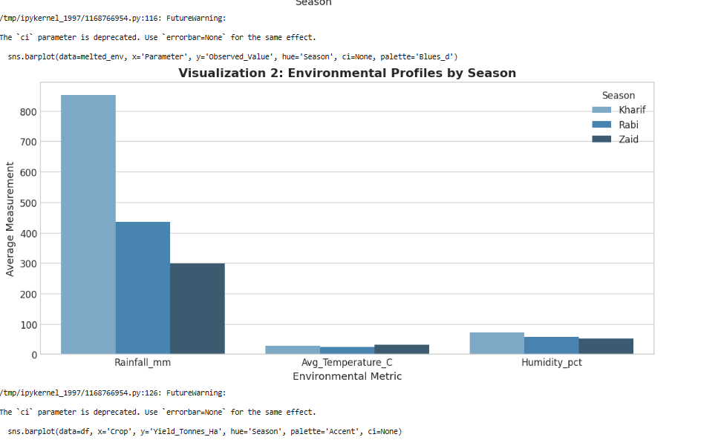
RESULTS
[Add screen shots of your code ]

Slide 8
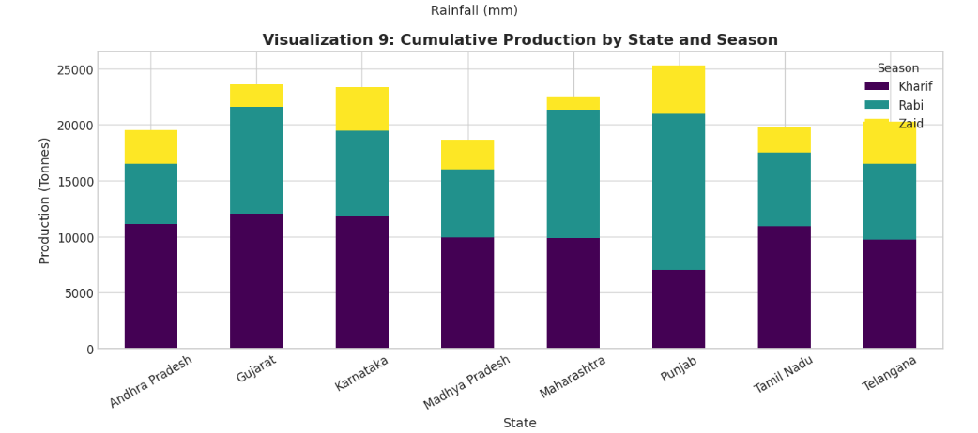
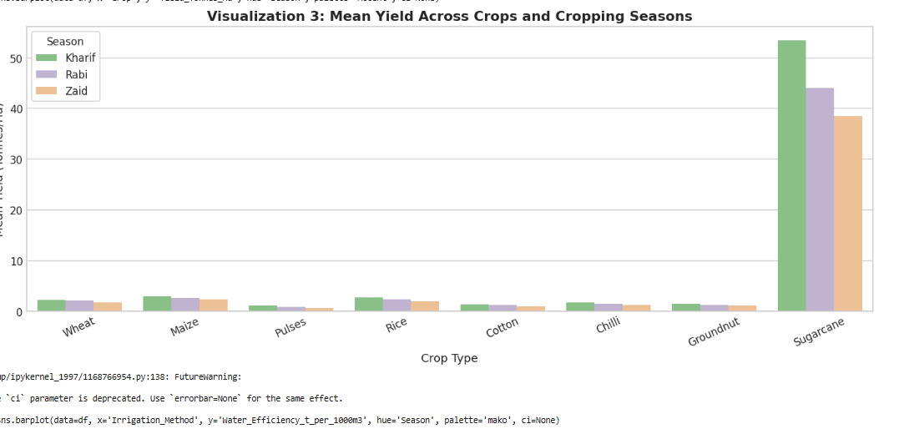
RESULTS
[Add screen shots of your code ]

Slide 9
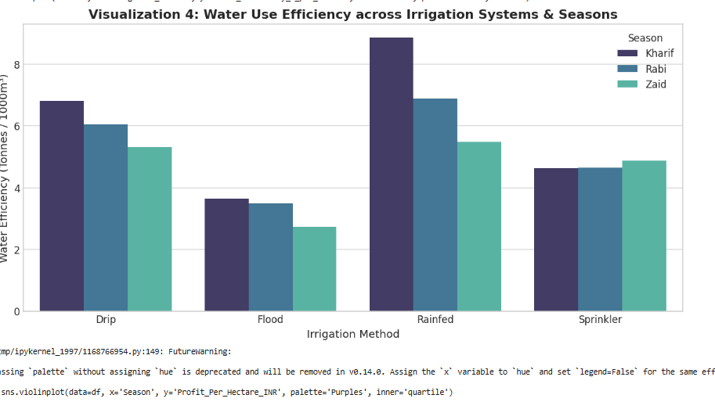
RESULTS
[Add screen shots of your code ]

Slide 10
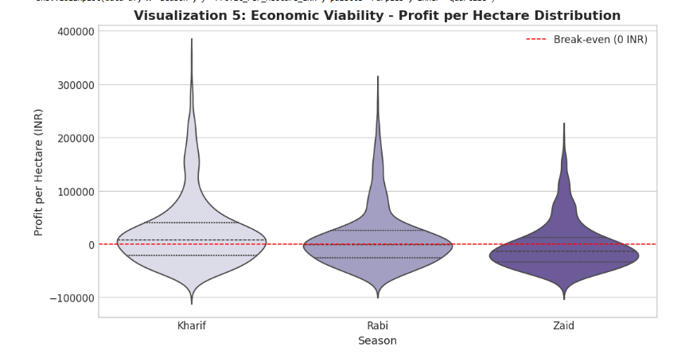
RESULTS
[Add screen shots of your code ]

Slide 11
Future scope
Predictive ML Modeling: Train regression and tree-based models (e.g., XGBoost, Random Forest) to predict seasonal yield before sowing.
IoT & Real-time Integration: Incorporate live sensor data (soil moisture, temperature) to provide dynamic irrigation schedules.
Farm Advisory Mobile Application: Package findings into a lightweight mobile dashboard for local farmers to receive personalized input recommendations based on season and region.

Slide 12
GitHub Link
[https://github.com/patelapaman/VOIS_Major_Project_Sessional_agriculture_performance_data_analysis]

Slide 13
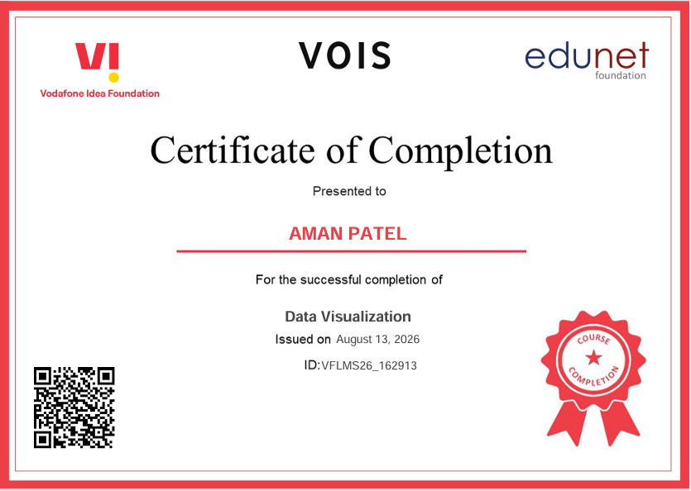
VOIS Course completion certificate - Course name- Data Visualization

Slide 14
Thank you
"Special thanks to VOIS and AICTE for the mentorship and learning opportunity throughout this project."
.
.

